Slide 1
Looping in Python
Programming language
Submitted by:
Nupriya Saxena
SciFor Technology
ID Number- MST03-0027

Slide 2
Introduction
A loop is an instruction that repeats multiple times as long as some condition is met. It is one of the most fundamental concepts in programming, and it is used in almost every programming language.

Slide 3
Loop
A loop is a programming structure that allows you to repeat a set of instructions until a specific condition is met. This is useful for tasks that need to be repeated multiple times
Loop change the flow control of program that is why it is also called control structures

Slide 4
Real World Examples of Loop
Software of the ATM machine is in a loop to process transaction after transaction until you acknowledge that you have no more to do.
Software program in a mobile device allows user to unlock the mobile with 5 password attempts. After that it resets mobile device.
You put your favorite song on a repeat mode. It is also a loop.
You want to run a particular analysis on each column of your data set.

Slide 5
It is one of the most commonly used loop method to automate the repetitive tasks.
Suppose you are asked to print sequence of numbers from 1 to 9, increment by 2.
for i in range(1,10,2):
print(i)
Output:1
3
5
7
9

Slide 6
Types of loop
There are mainly three types of loops. Let’s discuss them one by one.
For loop
While loop
Nested loop

Slide 7
For loop
A for loop in Python is used to iterate over a sequence.
a control flow statement that is used to repeatedly execute a group of statements as long as the condition is satisfied.

Slide 8
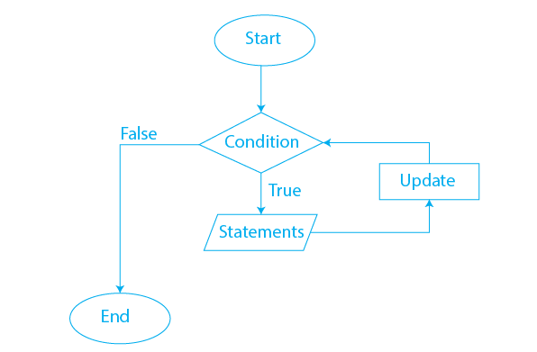
Flowchat of For loop

Slide 9
Example of for loop
numbers = [1, 2, 3, 4, 5]
for i in numbers:
print(i)
Output:-1
2
3
4
5

Slide 10
While loop
used to repeat a specific block of code an unknown number of times, until a condition is met.
while loop is a control flow statement that allows code to be executed repeatedly based on a given Boolean condition.

Slide 11
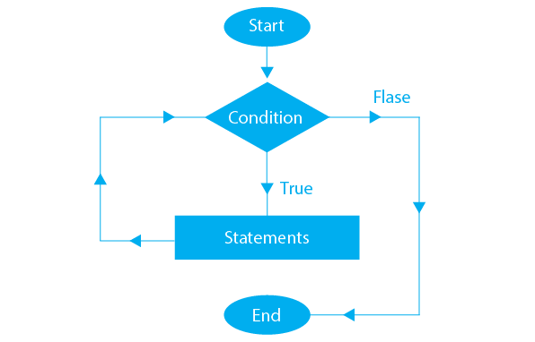
Flowchart of while loop

Slide 12
Example of while loop
count = 0
while (count < 3):
count = count + 1
print("Hello")
Output:-
Hello
Hello
Hello

Slide 13
Nested loop
A nested loop means a loop statement inside another loop statement. That is why nested loops are also called “loop inside loops“.
The outer loop runs first, and each time it runs, the inner loop runs as well.

Slide 14
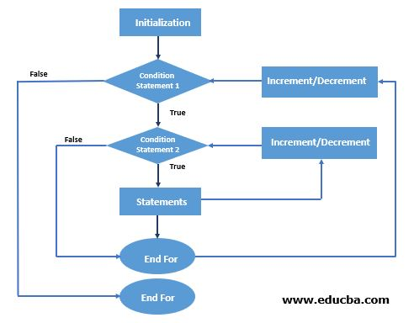
Flowchart of nested loop

Slide 15
Example of nested loop
for i in range(6):
for j in range(i):
print('*', end='')
print(‘ ')
Output:-
*
**
***
****
*****

Slide 16
Difference between for and while loop
The main difference between a for loop and a while loop is that the for loop repeats a block of code a specific number of times, whereas the while loop repeats a block of code until a condition is met.

Slide 17

This power point presentation under the guidance of my mentor UROOJ KHAN which provide me such type of opportunity.

